Slide 1


SMART INDIA HACKATHON 2025
TITLE PAGE
Problem Statement ID – SIH25034
Problem Statement Title-AI-Based intership Recommendation Engine For PM internship scheme
Theme- humanised
PS Category- Software
Team ID- 28
Team Name (VIRTUAL WIZARDS )

Slide 2
IDEA TITLE “AI-Driven Internship Guidance for PM Scheme”
VIRTUAL WIZARDS
Detailed explanation of the proposed solution
Students fill out their profile with skills, education, interests, and preferences.
The system gathers internship details from the PM Internship Scheme and other official sources.
Uses machine learning to match student profiles with internship requirements based on skills, interests, and qualifications.
Shows ranked internship recommendations with reasons and sends alerts for new matching opportunities.
How it addresses the problem
Students don’t have to browse through hundreds of listings to find relevant internships.
AI recommends internships based on the student’s actual profile, increasing chances of acceptance.
Helps students from rural or remote areas find internships suited to them.
Keeps students updated about new opportunities aligned with their interests and skills.
Innovation and uniqueness
I-Driven Personalization
Multilingual & Inclusive Design
Skill & Soft Skill Matching

Slide 3
TECHNICAL APPROACH
VIRTUAL WIZARDS
Technologies used (software)
Frontend (User Interface):
HTML, CSS, JavaScript – To create a clean and user-friendly web interface
Backend (Server-side):
Python with Flask – To handle data processing, APIs, and AI logic.
Methodology and process
The system starts with Student Profile creation
Three key modules (Online Social, Collaborative Filtering,
and Knowledge Graph) combine to generate Ranked Results.
A Personalized Dashboard displays recommendations,
leading to student interaction like Company Applications and tracking.
Student Feedback and application outcomes
continuously Improve Future AI Models.

Slide 4
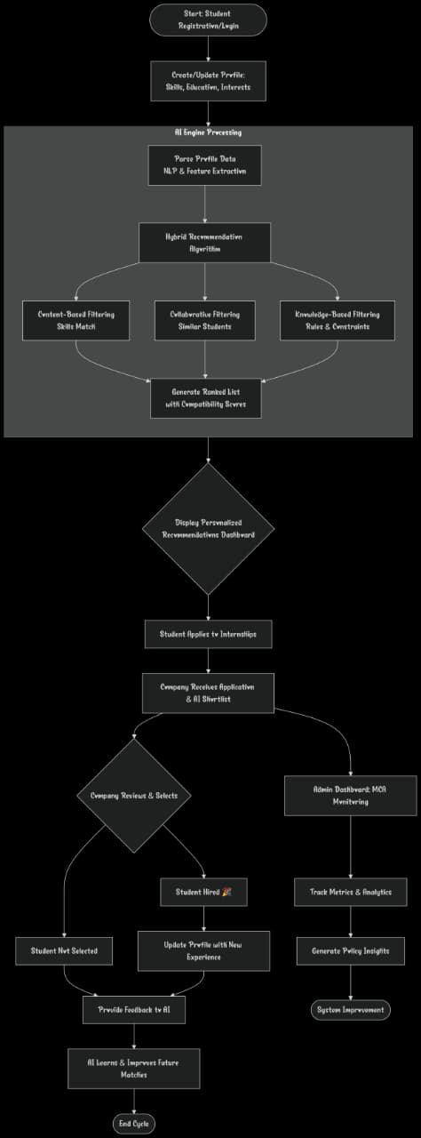
Flow chart

Slide 5
FEASIBILITY AND VIABILITY
VIRTUAL WIZARDS
✅ Feasibility
Data acces
Resource Availability
Technical Feasibility
Scalability
⚠️ Challenges
Data collection
User Diversity
cold start problem
internet Accessiliblity
🛡️ Strategies
Wed scarping&APIs
Multilingul support
Smart onbording
offline/ Lite version

Slide 6
IMPACT AND BENEFITS
VIRTUAL WIZARDS
Potential impact on the target audience
Helps students find better opportunities they may not have discovered on their own.
Matches internships with student skills and interests, improving the chances of success.
Supports students from rural and underserved areas by making internships more accessible.
Builds confidence in students by showing them personalized and achievable opportunities.
Benefits of the solution (social, economic, environmental, etc.)
Social Benefit: Gives equal access to internships for all, regardless of background.
Economic Benefit: Increases job-readiness and future earning potential of students.
Educational Benefit: Motivates students to learn relevant skills based on recommendations.
Environmental Benefit: Reduces travel and paperwork by digitizing the internship process.

Slide 7
RESEARCH AND REFERENCES
VIRTUAL WIZARDS
Details / Links of the reference and research work
https://www.thehindu.com/news/national/pm-internship-scheme-rolled-out-on-pilot-basis-aims-to-provide-1-crore-internships-over-five-years/article68713887.ec
https://www.indiatoday.in/education-today/news/story/pm-internship-scheme-mobile-app-launched-to-help-youth-find-internships-faster-2695251-2025-03-18?utm_source
https://www.business-standard.com/india-news/fm-nirmala-sitharaman-launches-mobile-app-for-pm-internship-scheme-125031700993_1.html

Slide 8
IMPORTANT INSTRUCTIONS
Please ensure below pointers are met while submitting the Idea PPT:
Kindly keep the maximum slides limit up to six (6). ( Including the title slide)
Try to avoid paragraphs and post your idea in points /diagrams / Infographics /pictures
Keep your explanation precise and easy to understand
Idea should be unique and novel.
You can only use provided template for making the PPT without changing the idea details pointers (mentioned in previous slides).
You need to save the file in PDF and upload the same on portal. No PPT, Word Doc or any other format will be supported.
Note - You can delete this slide (Important Pointers) when you upload the details of your idea on SIH portal.

